Slide 1


.NET Aspire
Vladislav Antonyuk
Notes:
Hello everyone! Welcome to the conference. Today we will talk about .NET Aspire

Slide 2




Speaker
Vladislav Antonyuk
Senior .NET Developer
Microsoft MVP
.NET MAUI Community Toolkit Core Maintainer
https://vladislavantonyuk.github.io | https://www.linkedin.com/in/vladislav-antonyuk/ | https://youtube.com/@VladislavAntonyuk
Notes:
A few words about me. I am a Senior .NET Developer at DataArt, a Microsoft MVP, many may already know me from the .NET MAUI Community as I am one of the .NET MAUI Community Toolkit Core Maintainers. You can also find interesting videos and publications on my website, LinkedIn and YouTube.

Slide 3
.NET Aspire
.NET Aspire is an opinionated, cloud ready stack for building observable, production ready, distributed applications.
It is designed to improve the experience of building .NET cloud-native apps.
1
2
3
Orchestration
Integrations
Tooling
Notes:
But today we are talking not about .NET MAUI, but about .NET Aspire.
.NET Aspire is designed to improve the experience of building .NET cloud-native apps. It provides a consistent, opinionated set of tools and patterns that help you build and run distributed apps. .NET Aspire is designed to help you with: Orchestration, Integrations and Tooling

Slide 4
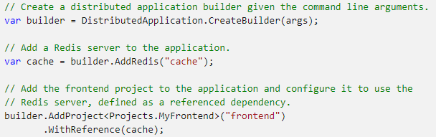
Orchestration
App composition: Specify the .NET projects, containers, executables, and cloud resources that make up the application.
Service discovery and connection string management: The app host manages injecting the right connection strings or network configurations and service discovery information to simplify the developer experience.
Notes:
In .NET Aspire, orchestration primarily focuses on enhancing the local development experience by simplifying the management of your cloud-native app's configuration and interconnections.
.NET Aspire orchestration assists with the following concerns:

Slide 5
.NET Aspire integrations
builder.AddAzureServiceBusClient("servicebus");
Registers a ServiceBusClient as a singleton in the DI container for connecting to Azure Service Bus.
Applies ServiceBusClient configurations either inline through code or through configuration.
Enables corresponding health checks, logging and telemetry specific to the Azure Service Bus usage.
https://learn.microsoft.com/en-gb/dotnet/aspire/fundamentals/integrations-overview
Notes:
.NET Aspire integrations are NuGet packages designed to simplify connections to popular services and platforms, such as Redis or PostgreSQL. .NET Aspire integrations handle many cloud-native concerns for you through standardized configuration patterns, such as adding health checks and telemetry.

Slide 6
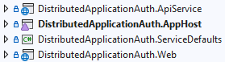
Project templates and tooling
Notes:
.NET Aspire comes with project templates and tooling experiences for Visual Studio, Visual Studio Code, and the dotnet CLI to help you create and interact with .NET Aspire projects.

Slide 7
Demo
Notes:
So let’s build our first .NET Aspire Project

Slide 8
References
R1
https://learn.microsoft.com/en-gb/dotnet/aspire/get-started/aspire-overview
R2
https://github.com/VladislavAntonyuk/AspireSamples
Notes:
Official documentation and samples can be found on these websites

Slide 9
Thank
You!
Notes:
This is the end of my presentation, thank you for your attention.

